Slide 1

Product Recommendation and Cross Selling System
Bravo Team
14 Feb. 2022

Slide 2

Outlines
Introduction and problem statement.
Business goals.
Business Objective .
Data Management Plan.
Software Architecture.

Slide 3

Introduction and problem statement
Competitions between supermarkets have been increased rapidly in local market. In the current situation, the offers selection criteria did not meet customers needs and expectations. There is a need to develop solutions supports offers selection that meets with customers needs as will as increase the sales revenue of the supermarket in a way that’s makes win-win relationship

Slide 4

Business goals
Provide a decision support system base on Machine Learning for cross-selling recommendation to help mangers build effective offers.
A real time dashboard for management reporting to show offers performance.

Slide 5

  Business Objectives
Enhance the competitive position and increasing the market share.
Increase the efficiency of cross-selling offers.
Improve the sales strategy based on customer behavior in buying process.
Achieving customer satisfaction and maintain customer retention .

Slide 6

  Data Management Plan
The Data Management Plan (DMP) contains the following:
Information about data ( Data source , Data type and format , Data Processing) .
Metadata, Data Types, and Counts.
Policies for access, sharing & reuse.
Data storage and ethics.

Slide 7

  Information about data
The source of data will be the reliable set of transactions data from Retail store/ Supermarket’s point of sales or extracting from API as MS access file (.accdb).
Dataset divided into the following :
Client Data , Products Data, Customers Data and Transaction Data

Slide 8
  Information about data
Client Data
Our client
Client_Id | Integer
Name | String
Location | String
Branch_Id | Integer
Branch_Name | String
Branch_Location | String
Our client
Client_Id | 12345
Name | Bravo
Location | Ramallah
Branch_Id | 12345007
Branch_Name | Blaza
Branch_Location | Nablus Street

Slide 9
  Information about data
Products Data
Products
Product_Id | Integer
Product_Name | String
Branch_Id | Integer
Quantity | Integer
Cost_Price | Integer
Sales_Price | Integer
Category_ID | Integer
Category_Name | String
Products
Product_Id | 789
Product_Name | Milk
Branch_Id | 123450007
Quantity | 1000
Cost_Price | 10
Sales_Price | 15
Category_ID | 60
Category_Name | dairy

Slide 10
  Information about data
Customers Data
Customers
Customer_Id | Integer
Gender | String
Age | Integer
Address | String
Income | Integer
Status | String
Customers
Customer_Id | 98756
Gender | Female
Age | 26
Address | Ramallah
Income | 7000
Status | married

Slide 11
  Information about data
Transaction Data
Transaction
Transaction_Id | Integer
Transaction_DateTime | DateTime
Product_Id | Integer
Product_Name | String
Quantity | Integer
Sales_Price | Ineger
Discount_Value | Integer
Vat_Value | Integer
Net_Transaction | Integer
Branch_Id | Integer
Branch_Name | String
Branch_Location | String
Category_ID | Integer
Category_Name | String
Transaction
Transaction_Id | 55555
Transaction_DateTime | 05/10/2021: Tues.: 13:35
Product_Id | 789
Product_Name | Milk
Quantity | 4
Sales_Price | 15
Discount_Value | 2
Vat_Value | 2.55
Net_Transaction | 10.45
Branch_Id | 12345007
Branch_Name | Blaza
Branch_Location | Nablus Street
Category_ID | 60
Category_Name | dairy

Slide 12

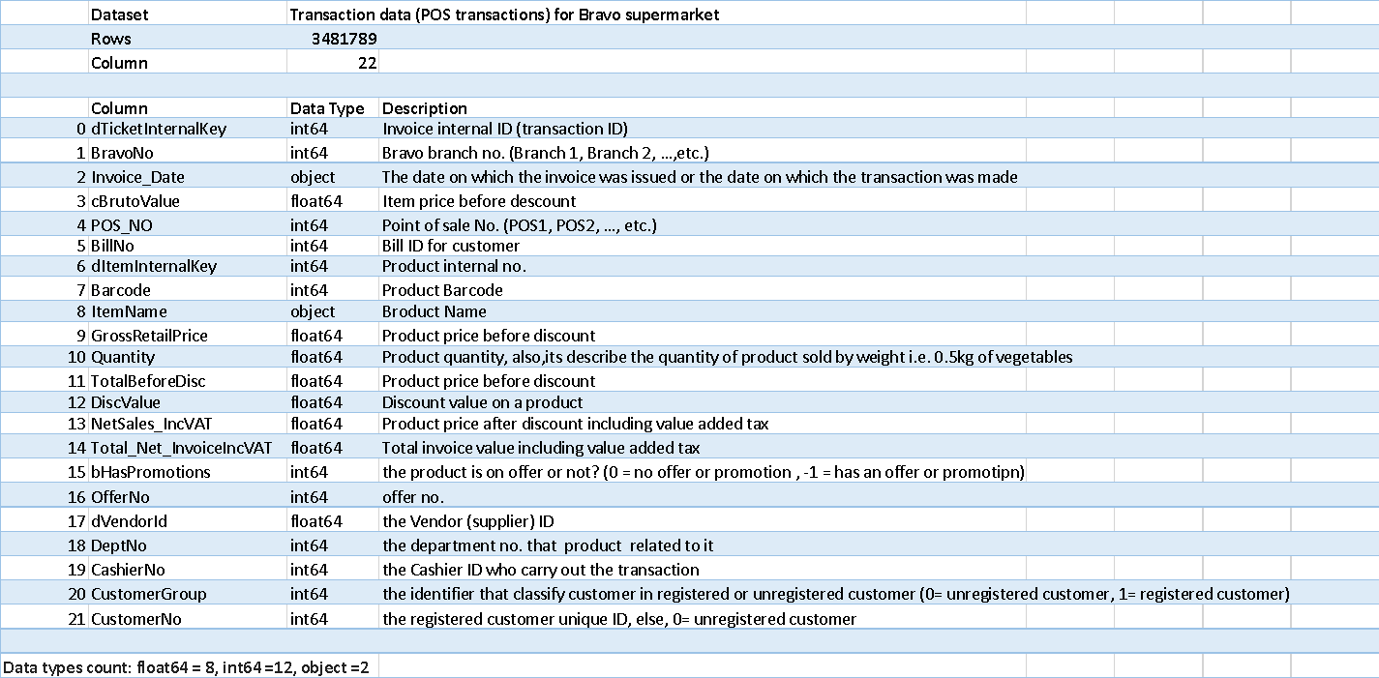
  Metadata, Data type & Counts
click Metadata.xlsx to preview

Slide 13

  Policies for access, sharing & reuse
In our system we are dealing with a sensitive data and this data is dedicated only for the retail store which will use the system, so we must put a high restriction on access and use the data.
For the system customers they will have the following authorities:
Connect their point of sales API with our system for data integration.
Use the basic features to get a result from the system model offer recommendation and dashboard.
Export the result from the system.
Delete their databases and the generated results from the local and cloud server.

Slide 14
  Policies for access, sharing & reuse
For the system Admin they will have the following authorities:
Monitor a real time dashboard for offers performance.
View the system code for model tuning, auditing, features enhancements and software upgrade in general.
Integrate the system APIs, cloud, and local servers to save the data for short and long-terms.

Slide 15

  Ethics
The databases and the generated reports are sensitive data and its customers owned .
No one has the authority to use and share this data, so we have to sign an agreement between the system owner and the customer to preserve his right and go to court in case the data was leaked.

Slide 16

  Data storage
We will store the data on the password protected cloud server and it will also be backed up on a local password protected RAID/network drive.
The data will be stored safely and securely and in full compliance with European Union data protection laws.

Slide 17
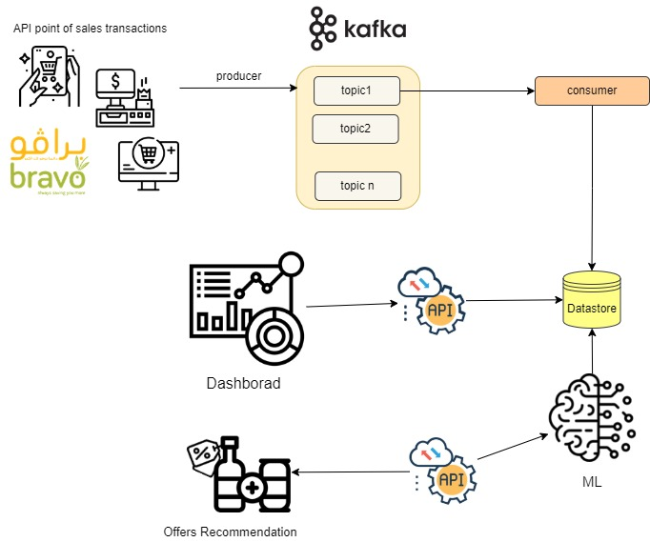
General Architecture

Slide 18
Technologies used
Real Time Dashboard :
Kafka
Angular
MongoDB
FastAPI
Recommendation offer:
Unsupervised Learning:
Association Analysis:
Apriori Algorithm.
FPGrowth Algorithm.

Slide 19
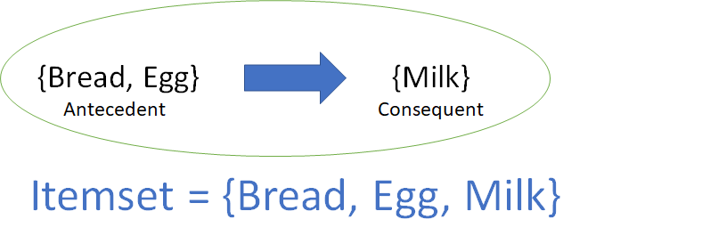
Association Rules
Uncover all such relationships between items from huge databases.
Find relationships between set of elements of every distinct transaction.
For a given rule, and itemset consist of antecedent items and consequent items

Slide 20
The Strength of Association (Interestingness)
Support [0,1]
gives an idea of how frequent an itemset is in all the transactions.
Confidence [0,1]
defines the likeliness of occurrence of consequent on the cart given that the cart already has the antecedents.
Lift [0, ∞]
Lift controls for the support (frequency) of consequent while calculating the conditional probability of occurrence of {Y} given {X}.
Notes:
Ref: https://towardsdatascience.com/association-rules-2-aa9a77241654

Slide 21

Thank You for Your Attention!

